Slide 1
DS101
LECTURE 01
ROADMAP AND FOUNDATIONS
Data Science Architect
Roadmap & Foundations
Frame the problem
From a problem to a model
we can evaluate and use.
Understand the data
LECTURE 01
DATA SCIENCE
Evaluate the result
The model is a means. The decision is the point.
DS101 | 2026-2027
01 / 24
Notes:
Introduce the theme without reading a syllabus paragraph. Ask students what makes a prediction useful, not which model they would pick. The formal course title and current course year are retained.
Instructor guidance: Keep the explanation oral; pause on the visual before revealing the conclusion.
Revision provenance: Original L01 slide(s) 1. Original repository commit d2610b64b34c9699073df88b5d29ec7e6cb4ef13.
[Sources]
https://github.com/Ratio1/DS101-template/blob/d2610b64b34c9699073df88b5d29ec7e6cb4ef13/scripts/lecture_2026_content.py
[/Sources]

Slide 2
DS101
LECTURE 01
LECTURE PLAN
Today: from a problem to a usable result
01
02
03
04
The role
The lifecycle
Models and errors
Project expectations
What does a Data Scientist decide?
How does data become a product?
What is learned, and how is it tested?
What must a complete project show?
Define the problem. Explain the error. Choose the next step.
DS101 | 2026-2027
02 / 24
Notes:
This replaces, rather than restyles, the old 100-minute administrative agenda. Suggested pacing retains the existing 100-minute total. Teach role and expectations, then prerequisites and map, lifecycle and ETL, metrics and optimization, and a worked example/discussion. Keep transitions and recovery in notes, not on screen.
Instructor guidance: Keep the explanation oral; pause on the visual before revealing the conclusion.
Revision provenance: Original L01 slide(s) 2. Original repository commit d2610b64b34c9699073df88b5d29ec7e6cb4ef13.
[Sources]
https://github.com/Ratio1/DS101-template/blob/d2610b64b34c9699073df88b5d29ec7e6cb4ef13/scripts/lecture_2026_content.py
[/Sources]

Slide 3
DS101
LECTURE 01
FOUNDATIONS
Choose the tool after the problem
Data
THEN COMPARE
What can be observed?
Simple rule
Linear or tree
Neural network
Loss
What must
the system predict?
What counts as an error?
Evaluation
What would justify use?
Deep learning is part of Data Science, not a replacement for it.
DS101 | 2026-2027
03 / 24
Notes:
Preserve the original problem-specific engineering message. Do not imply that deep learning is always necessary or that one family dominates all tasks. Ask for a simple baseline before inviting a more complex architecture.
Instructor guidance: Keep the explanation oral; pause on the visual before revealing the conclusion.
Revision provenance: Original L01 slide(s) 3. Original repository commit d2610b64b34c9699073df88b5d29ec7e6cb4ef13.
[Sources]
https://github.com/Ratio1/DS101-template/blob/d2610b64b34c9699073df88b5d29ec7e6cb4ef13/scripts/lecture_2026_content.py
https://developers.google.com/machine-learning/crash-course/linear-regression
[/Sources]

Slide 4
DS101
LECTURE 01
THE DATA SCIENTIST ROLE
Turn observations into decisions
Frame
Test
Operate
Define the user, target,
and consequence of error.
Compare models with
credible evaluation.
Make the result usable,
observable, and reversible.
The domain changes. These responsibilities remain.
DS101 | 2026-2027
04 / 24
Notes:
Use the next three domain examples to show the same role under different observations and consequences. Do not repeat unsupported workforce-size or scarcity statistics from historical slides.
Instructor guidance: Keep the explanation oral; pause on the visual before revealing the conclusion.
Revision provenance: Original L01 slide(s) 4. Original repository commit d2610b64b34c9699073df88b5d29ec7e6cb4ef13.
[Sources]
https://github.com/Ratio1/DS101-template/blob/d2610b64b34c9699073df88b5d29ec7e6cb4ef13/scripts/lecture_2026_content.py
[/Sources]

Slide 5
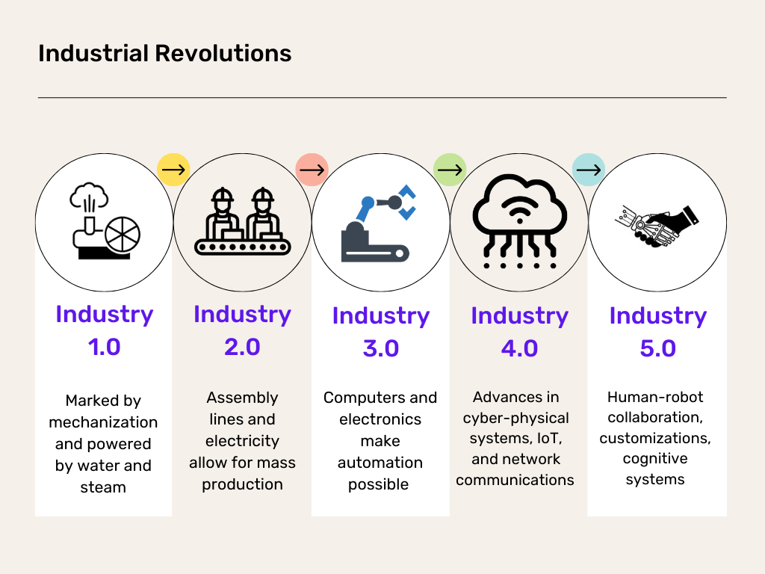
DS101
LECTURE 01
DOMAIN EXAMPLE
Industry: from automation to better decisions
What evidence would justify stopping a production line?
DS101 | 2026-2027
05 / 24
Notes:
Industry - original historical illustration restored.
The original image from archive slide 4 replaces only the reconstructed domain graphic. Preserve the original artwork, labels, aspect ratio and full image; do not redraw or generate a replacement. Treat the historical evolutionary framing as a conceptual discussion, not a measured sequence or universal guarantee.
Discussion: What evidence would justify stopping a production line?
The revised title, header, footer and discussion prompt are unchanged.
[Sources]
https://github.com/Ratio1/DS101-template/blob/b3ff1a70341dbf0945f0da36c23d1f0226b30247/_lectures_archives/2025/DS101%20Lecture%201.pptx
Archived source slide 4 (D1S04); embedded image SHA-256 16043be9ac432d96a343ecfe55a0788b63b7098ce8f4d1323170aef9084fcf1d.
Reuse of the archived image does not independently certify its historical claims or upstream licensing.

Slide 6
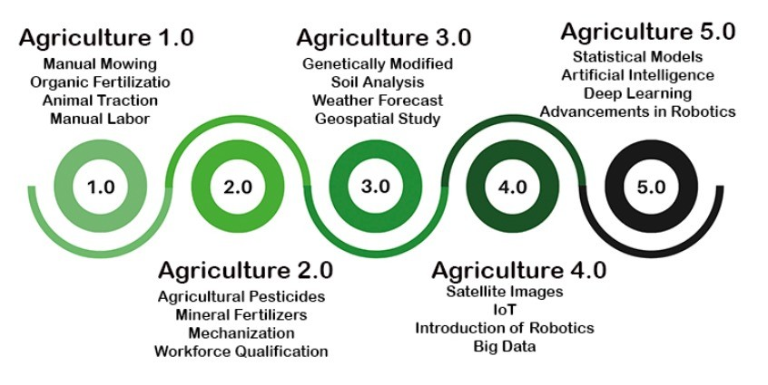
DS101
LECTURE 01
DOMAIN EXAMPLE
Agriculture: from observations to targeted action
Which observation would change an irrigation decision?
DS101 | 2026-2027
06 / 24
Notes:
Agriculture - original historical illustration restored.
The original image from archive slide 5 replaces only the reconstructed domain graphic. Preserve the original artwork, labels, aspect ratio and full image; do not redraw or generate a replacement. Treat the historical evolutionary framing as a conceptual discussion, not a measured sequence or universal guarantee.
Discussion: Which observation would change an irrigation decision?
The revised title, header, footer and discussion prompt are unchanged.
[Sources]
https://github.com/Ratio1/DS101-template/blob/b3ff1a70341dbf0945f0da36c23d1f0226b30247/_lectures_archives/2025/DS101%20Lecture%201.pptx
Archived source slide 5 (D1S05); embedded image SHA-256 6614fe0a12fd4000ed58e118b1346d975a9d823c235de08787fbe72fc0e0c0ac.
Reuse of the archived image does not independently certify its historical claims or upstream licensing.

Slide 7
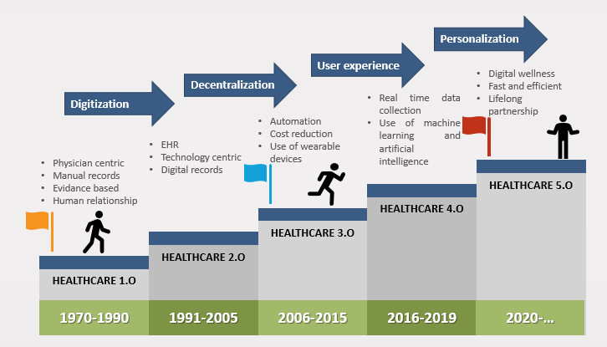
DS101
LECTURE 01
DOMAIN EXAMPLE
Healthcare: from records to reviewed decisions
A risk score is an input to a decision, not the decision itself.
DS101 | 2026-2027
07 / 24
Notes:
Healthcare - original historical illustration restored.
The original image from archive slide 6 replaces only the reconstructed domain graphic. Preserve the original artwork, labels, aspect ratio and full image; do not redraw or generate a replacement. Treat the historical evolutionary framing as a conceptual discussion, not a measured sequence or universal guarantee.
Discussion: A risk score is an input to a decision, not the decision itself.
The revised title, header, footer and discussion prompt are unchanged.
[Sources]
https://github.com/Ratio1/DS101-template/blob/b3ff1a70341dbf0945f0da36c23d1f0226b30247/_lectures_archives/2025/DS101%20Lecture%201.pptx
Archived source slide 6 (D1S06); embedded image SHA-256 9b10f8cccb1668651cdbf29dd2b96c01a8262a5e0630de0985e2f0215d28d58b.
Reuse of the archived image does not independently certify its historical claims or upstream licensing.

Slide 8
DS101
LECTURE 01
COURSE EXPECTATIONS
How the course is assessed
FINAL GRADE
30%
70%
Individual presentation
End-to-end project
Research paper or
approved technical topic
Repository, report, demonstration,
and oral defense
You must be able to explain and defend every submitted artifact.
DS101 | 2026-2027
08 / 24
Notes:
The weights are unchanged. The filled rectangles now sum to 100%, with exactly 30% and 70% of the common width. Generated assistance must be disclosed and understood. Do not introduce extra credit or a new graded assignment.
Instructor guidance: Keep the explanation oral; pause on the visual before revealing the conclusion.
Revision provenance: Original L01 slide(s) 8. Original repository commit d2610b64b34c9699073df88b5d29ec7e6cb4ef13.
[Sources]
https://github.com/Ratio1/DS101-template/blob/d2610b64b34c9699073df88b5d29ec7e6cb4ef13/scripts/lecture_2026_content.py
https://github.com/Ratio1/DS101-template/blob/d2610b64b34c9699073df88b5d29ec7e6cb4ef13/README.md
[/Sources]

Slide 9
DS101
LECTURE 01
PREREQUISITES
The working tools behind this lecture
Mathematics
Python and data
Reproducible work
Vectors and matrices
Derivatives
Probability
NumPy and pandas
Jupyter or an IDE
Inspect and plot
Git and environments
Versioned inputs
Reproducible runs
Check: if X is 4 x 3 and w is 3 x 1, what is the shape of Xw?
DS101 | 2026-2027
09 / 24
Notes:
Expected answer: 4 x 1. This is a diagnostic, not an assessment addition. Revisit matrix multiplication and derivatives as needed. Link only verified preparation resources in the learning platform. Keep environment installation outside this lecture.
Instructor guidance: Keep the explanation oral; pause on the visual before revealing the conclusion.
Revision provenance: Original L01 slide(s) 9. Original repository commit d2610b64b34c9699073df88b5d29ec7e6cb4ef13.
[Sources]
https://github.com/Ratio1/DS101-template/blob/d2610b64b34c9699073df88b5d29ec7e6cb4ef13/scripts/lecture_2026_content.py
[/Sources]

Slide 10
DS101
LECTURE 01
COURSE MAP
The full lifecycle starts before modeling
01
Frame
02
Acquire
03
Prepare
04
Explore
User and decision
Source and rights
Schema and features
Patterns and questions
08
Monitor
07
Serve
06
Evaluate
05
Model
Change and recovery
User interaction
Errors and limits
Baseline and fit
Each stage changes what the final result can legitimately claim.
DS101 | 2026-2027
10 / 24
Notes:
Walk the upper row left to right and lower row right to left. Explain the feedback loop verbally: monitoring can send us back to problem framing or data collection. Tools assist the lifecycle but do not substitute for statistical judgment.
Instructor guidance: Keep the explanation oral; pause on the visual before revealing the conclusion.
Revision provenance: Original L01 slide(s) 10. Original repository commit d2610b64b34c9699073df88b5d29ec7e6cb4ef13.
[Sources]
https://github.com/Ratio1/DS101-template/blob/d2610b64b34c9699073df88b5d29ec7e6cb4ef13/scripts/lecture_2026_content.py
[/Sources]

Slide 11
DS101
LECTURE 01
PROBLEM FRAMING
What should the model output?
REGRESSION
CLASSIFICATION
180,000 EUR
FAULT / NO FAULT
A numerical value
A category or class probability
Example: price estimate
Error: distance from the observed value
Example: equipment-fault alert
Error: false alarm or missed fault
Define the output and the consequence of a wrong answer first.
DS101 | 2026-2027
11 / 24
Notes:
Regression and classification are two common task types, not an exhaustive taxonomy. An output-type distinction is not the same as generative/discriminative modeling or deterministic/stochastic execution. The prior axis conflated these distinctions and is removed. The numeric example is illustrative, not a measured model prediction.
Instructor guidance: Keep the explanation oral; pause on the visual before revealing the conclusion.
Revision provenance: Original L01 slide(s) 11. Original repository commit d2610b64b34c9699073df88b5d29ec7e6cb4ef13.
[Sources]
https://github.com/Ratio1/DS101-template/blob/d2610b64b34c9699073df88b5d29ec7e6cb4ef13/scripts/lecture_2026_content.py
https://developers.google.com/machine-learning/crash-course/linear-regression
https://developers.google.com/machine-learning/gan/generative
https://developers.google.com/machine-learning/crash-course/classification/accuracy-precision-recall
[/Sources]

Slide 12
DS101
LECTURE 01
DATA PREPARATION
From raw records to usable features
RAW RECORD
TYPED RECORD
Area
"80 m2"
area_m2
80
number
Rooms
"3"
rooms
3
integer
Validate
Transform
Price
"180,000 EUR"
price_eur
180000
number
ILLUSTRATIVE RECORD - NOT A COURSE-DATA EXTRACT
Preserve the raw data. Record the transformation and its assumptions.
DS101 | 2026-2027
12 / 24
Notes:
Explain units, types, provenance, and rights. The displayed record is constructed solely to illustrate ETL, not sampled from imobiliare_bucuresti.csv. Distinguish parsing from learned preprocessing. Fit imputers, scalers, and other learned transformations using training data only.
Instructor guidance: Keep the explanation oral; pause on the visual before revealing the conclusion.
Revision provenance: Original L01 slide(s) 12. Original repository commit d2610b64b34c9699073df88b5d29ec7e6cb4ef13.
[Sources]
https://github.com/Ratio1/DS101-template/blob/d2610b64b34c9699073df88b5d29ec7e6cb4ef13/scripts/lecture_2026_content.py
https://scikit-learn.org/stable/common_pitfalls.html
[/Sources]

Slide 13
DS101
LECTURE 01
EVALUATION
80% accuracy can miss every positive
100 OBSERVATIONS
MODEL PREDICTS NEGATIVE EVERY TIME
Pred. negative
Pred. positive
Actual negative
80
0
Actual positive
20
0
Accuracy
Positive-class recall
80 negative
20 positive
80%
0%
Which mistake matters more: a false alarm or a missed positive?
DS101 | 2026-2027
13 / 24
Notes:
A toy example: TN=80, FP=0, FN=20, TP=0. Accuracy=(TP+TN)/100=80%. Recall=TP/(TP+FN)=0%. Precision is undefined for this all-negative model because it makes no positive predictions; do not report zero precision without explicitly choosing a convention. The purpose is metric selection, not a real dataset claim.
Instructor guidance: Keep the explanation oral; pause on the visual before revealing the conclusion.
Revision provenance: Original L01 slide(s) 13. Original repository commit d2610b64b34c9699073df88b5d29ec7e6cb4ef13.
[Sources]
https://github.com/Ratio1/DS101-template/blob/d2610b64b34c9699073df88b5d29ec7e6cb4ef13/scripts/lecture_2026_content.py
https://developers.google.com/machine-learning/crash-course/classification/accuracy-precision-recall
[/Sources]

Slide 14
DS101
LECTURE 01
EXPLORATORY ANALYSIS
A plot should answer a question
Price (EUR thousands)
What explains this price?
QUESTION
300
How does price
relate to area?
250
200
Inspect the pattern.
Check unusual records.
Do not infer causation.
150
100
40
60
80
100
120
Illustrative data,
not a course result.
Area (square metres)
DS101 | 2026-2027
14 / 24
Notes:
The five points are synthetic: (40,110), (60,130), (80,190), (100,210), (120,280), with area in square metres and price in thousands of EUR. There is no claim that the largest observation is invalid. Ask for possible omitted variables and plausible data-quality checks. Reuse these points on the function-approximation and loss slides.
Instructor guidance: Keep the explanation oral; pause on the visual before revealing the conclusion.
Revision provenance: Original L01 slide(s) 14. Original repository commit d2610b64b34c9699073df88b5d29ec7e6cb4ef13.
[Sources]
https://github.com/Ratio1/DS101-template/blob/d2610b64b34c9699073df88b5d29ec7e6cb4ef13/scripts/lecture_2026_content.py
https://developers.google.com/machine-learning/crash-course/linear-regression
[/Sources]

Slide 15
DS101
LECTURE 01
FROM MODEL TO USE
The model is not the whole product
Request
Validate
Predict
Respond
User inputs
Schema and units
Versioned model
Result and context
Reject invalid input
Observe failures. Keep the model identity. Plan recovery.
DS101 | 2026-2027
15 / 24
Notes:
This is a conceptual product boundary, not a claim that all controls have already been implemented in the course app. Examples include missing fields, wrong units, and inputs outside the intended use. A model can be numerically correct yet used incorrectly. Serving, monitoring and rollback are introduced here and developed in later lectures.
Instructor guidance: Keep the explanation oral; pause on the visual before revealing the conclusion.
Revision provenance: Original L01 slide(s) 15. Original repository commit d2610b64b34c9699073df88b5d29ec7e6cb4ef13.
[Sources]
https://github.com/Ratio1/DS101-template/blob/d2610b64b34c9699073df88b5d29ec7e6cb4ef13/scripts/lecture_2026_content.py
[/Sources]

Slide 16
DS101
LECTURE 01
FUNCTION APPROXIMATION
A model approximates a relationship
Price (EUR thousands)
ILLUSTRATIVE MODEL
300
250
200
x: area
y: price
b, w: parameters
150
100
An estimate,
not a guarantee.
40
60
80
100
120
Area (square metres)
DS101 | 2026-2027
16 / 24
Notes:
Use the same synthetic points as slide 14. The shown illustrative line is y_hat=20+2x, with y in thousands of EUR. It is a candidate model, not the least-squares optimum. Connect each symbol to the quantity on the axes. The dataset target must be verified before interpreting it as an asking price, transaction price, or valuation.
Instructor guidance: Keep the explanation oral; pause on the visual before revealing the conclusion.
Revision provenance: Original L01 slide(s) 16. Original repository commit d2610b64b34c9699073df88b5d29ec7e6cb4ef13.
[Sources]
https://github.com/Ratio1/DS101-template/blob/d2610b64b34c9699073df88b5d29ec7e6cb4ef13/scripts/lecture_2026_content.py
https://developers.google.com/machine-learning/crash-course/linear-regression
[/Sources]

Slide 17
DS101
LECTURE 01
OPTIMIZATION
Turn prediction errors into a loss
Price (EUR thousands)
MEAN SQUARED ERROR
300
250
200
Large errors
count more.
150
100
Same example:
MAE = 12,000 EUR
40
60
80
100
120
Area (square metres)
DS101 | 2026-2027
17 / 24
Notes:
For candidate line y_hat=20+2x, absolute errors in thousands of EUR are 10,10,10,10,20. MAE=12 thousand EUR. MSE=160 (thousand EUR)^2. These are synthetic in-sample explanatory calculations, not validation results. Explain the units of squared loss and distinguish training loss from the metric chosen to support an operational decision.
Instructor guidance: Keep the explanation oral; pause on the visual before revealing the conclusion.
Revision provenance: Original L01 slide(s) 17. Original repository commit d2610b64b34c9699073df88b5d29ec7e6cb4ef13.
[Sources]
https://github.com/Ratio1/DS101-template/blob/d2610b64b34c9699073df88b5d29ec7e6cb4ef13/scripts/lecture_2026_content.py
https://developers.google.com/machine-learning/crash-course/linear-regression/loss
[/Sources]

Slide 18
DS101
LECTURE 01
OPTIMIZATION
Least squares: a direct solution for a linear model
MINIMIZE THE SUM OF SQUARED ERRORS
WHAT TO REMEMBER
The inverse form requires
full column rank.
In code, use a
least-squares solver.
w = np.linalg.lstsq(X, y, rcond=None)[0]
DS101 | 2026-2027
18 / 24
Notes:
X includes an intercept column if the model requires one. Full column rank makes X^T X invertible. A Gaussian noise assumption is not required merely to compute ordinary least squares. In practical code, use a numerically appropriate solver rather than explicitly forming the inverse. For the five synthetic observations, the least-squares solution is intercept 16 and slope 2.1 in the displayed units. The original mathematical screenshot is reconstructed conceptually and not reproduced as an image.
Instructor guidance: Keep the explanation oral; pause on the visual before revealing the conclusion.
Revision provenance: Original L01 slide(s) 18. Original repository commit d2610b64b34c9699073df88b5d29ec7e6cb4ef13.
[Sources]
https://github.com/Ratio1/DS101-template/blob/d2610b64b34c9699073df88b5d29ec7e6cb4ef13/scripts/lecture_2026_content.py
https://numpy.org/doc/2.1/reference/generated/numpy.linalg.lstsq.html
[/Sources]

Slide 19
DS101
LECTURE 01
OPTIMIZATION
Gradient descent: improve the parameters step by step
Loss L(w)
UPDATE RULE
8
6
Toy example: x = 2, y = 4
4
w = 1
2
w = 1.4
1 - 0.1 x (-4) = 1.4
0
0
1
2
3
Loss: 2.00 -> 0.72
Parameter w
DS101 | 2026-2027
19 / 24
Notes:
The curve is exactly L(w)=1/2(2w-4)^2=2(w-2)^2. Starting from w=1 gives loss 2 and derivative -4. With eta=0.1, w becomes 1.4 and loss is 0.72. This toy example is separate from the earlier five-property dataset; label the change of example clearly. Discuss step size without claiming every update or learning rate guarantees a reduction.
Instructor guidance: Keep the explanation oral; pause on the visual before revealing the conclusion.
Revision provenance: Original L01 slide(s) 19. Original repository commit d2610b64b34c9699073df88b5d29ec7e6cb4ef13.
[Sources]
https://github.com/Ratio1/DS101-template/blob/d2610b64b34c9699073df88b5d29ec7e6cb4ef13/scripts/lecture_2026_content.py
https://developers.google.com/machine-learning/crash-course/linear-regression/gradient-descent
[/Sources]

Slide 20
DS101
LECTURE 01
COURSE ARCHITECTURE
New capabilities rest on the fundamentals
NextGenDS
YourAIYourData
Bounded agentic work
Tools, checks, and human decisions
Ownership and control
Privacy, locality, and operation
FUNDAMENTALS
Data | Mathematics | Models | Evaluation
DS101 | 2026-2027
20 / 24
Notes:
This is a dependency diagram, not a ranking of the three course pillars. Fundamentals are the supporting base. NextGenDS and YourAIYourData are complementary architectural responsibilities. Remove the former five-item pyramid and the unsupported implication created by placing fundamentals at its narrow top.
Instructor guidance: Keep the explanation oral; pause on the visual before revealing the conclusion.
Revision provenance: Original L01 slide(s) 20. Original repository commit d2610b64b34c9699073df88b5d29ec7e6cb4ef13.
[Sources]
https://github.com/Ratio1/DS101-template/blob/d2610b64b34c9699073df88b5d29ec7e6cb4ef13/scripts/lecture_2026_content.py
[/Sources]

Slide 21
DS101
LECTURE 01
PROJECT EXPECTATIONS
Your project must work end to end
A real problem
A complete workflow
A defensible result
Authorized data
Clear user and target
Prepare, model, evaluate
Serve a usable result
Repository and report
Demonstration and explanation
Explain your choices, including limitations and generated contributions.
DS101 | 2026-2027
21 / 24
Notes:
Preserve only the established full-pipeline and real-data requirements. Source rights, provenance, errors, reproducibility, and inspectable user interaction remain important. Do not assign the contested case-role hierarchy or add an unapproved graded submission. Evidence requirements for agent use remain conditional on actual agent use.
Instructor guidance: Keep the explanation oral; pause on the visual before revealing the conclusion.
Revision provenance: Original L01 slide(s) 21. Original repository commit d2610b64b34c9699073df88b5d29ec7e6cb4ef13.
[Sources]
https://github.com/Ratio1/DS101-template/blob/d2610b64b34c9699073df88b5d29ec7e6cb4ef13/scripts/lecture_2026_content.py
https://github.com/Ratio1/DS101-template/blob/d2610b64b34c9699073df88b5d29ec7e6cb4ef13/README.md
[/Sources]

Slide 22
DS101
LECTURE 01
PROBLEM-FRAMING GUIDE
Frame the problem before choosing an algorithm
What decision needs support?
YES
NO / NOT YET
Are useful targets available?
Predict a value or category
Explore structure or improve data
Define the horizon, errors, and split.
Do not invent a target or overstate the claim.
Then ask: what simple baseline would make the task worth doing?
DS101 | 2026-2027
22 / 24
Notes:
This is an introductory framing guide, not a complete machine-learning taxonomy. Other settings include learning from interaction, weak labels, and self-supervision. The image-only original framing tree could not be visually inspected; this is a concept-level reconstruction, and exact branch inheritance remains a review item. Preserve source provenance rather than claiming a pixel-faithful redraw.
Instructor guidance: Keep the explanation oral; pause on the visual before revealing the conclusion.
Revision provenance: Original L01 slide(s) 22. Original repository commit d2610b64b34c9699073df88b5d29ec7e6cb4ef13.
[Sources]
https://github.com/Ratio1/DS101-template/blob/d2610b64b34c9699073df88b5d29ec7e6cb4ef13/scripts/lecture_2026_content.py
https://developers.google.com/machine-learning/crash-course/linear-regression
[/Sources]

Slide 23
DS101
LECTURE 01
WORKED DISCUSSION
One example, three decisions
01
Target
What does the recorded price represent?
02
Inputs
An apartment-price estimate
Which fields exist at prediction time?
03
Evaluation
Illustrative case, not a new assignment.
How will we test on unseen examples?
Do not start training until these questions have clear answers.
DS101 | 2026-2027
23 / 24
Notes:
This is an in-class worked discussion, not the contested canonical-case hierarchy and not a required new deliverable. The existing real-estate data can be opened only after its schema and provenance have been checked in the teaching environment. Do not present invented records or expected metrics as actual dataset outputs. Give students time to distinguish asking price, sale price, and valuation without asserting which the unverified field represents.
Instructor guidance: Keep the explanation oral; pause on the visual before revealing the conclusion.
Revision provenance: Original L01 slide(s) 24. Original repository commit d2610b64b34c9699073df88b5d29ec7e6cb4ef13.
[Sources]
https://github.com/Ratio1/DS101-template/blob/d2610b64b34c9699073df88b5d29ec7e6cb4ef13/scripts/lecture_2026_content.py
https://scikit-learn.org/stable/common_pitfalls.html
[/Sources]

Slide 24
DS101
LECTURE 01
CLOSING
What to take away from Lecture 01
Start with the decision.
A model is a means, not the objective.
Trust the data and the test.
A good score needs a credible evaluation.
Explain how learning works.
Predictions, errors, loss, parameter updates.
NEXT: Data, exploratory analysis, and the Pharma case
DS101 | 2026-2027
24 / 24
Notes:
Ask one learner to connect the three statements using the worked example. Recap only concepts taught in the session. Do not finish by introducing an agentic contract or extra homework. The L02 topic is taken from the repository lecture sequence.
Instructor guidance: Keep the explanation oral; pause on the visual before revealing the conclusion.
Revision provenance: Original L01 slide(s) 25. Original repository commit d2610b64b34c9699073df88b5d29ec7e6cb4ef13.
[Sources]
https://github.com/Ratio1/DS101-template/blob/d2610b64b34c9699073df88b5d29ec7e6cb4ef13/scripts/lecture_2026_content.py
https://github.com/Ratio1/DS101-template/blob/d2610b64b34c9699073df88b5d29ec7e6cb4ef13/README.md
[/Sources]

